Slide 1
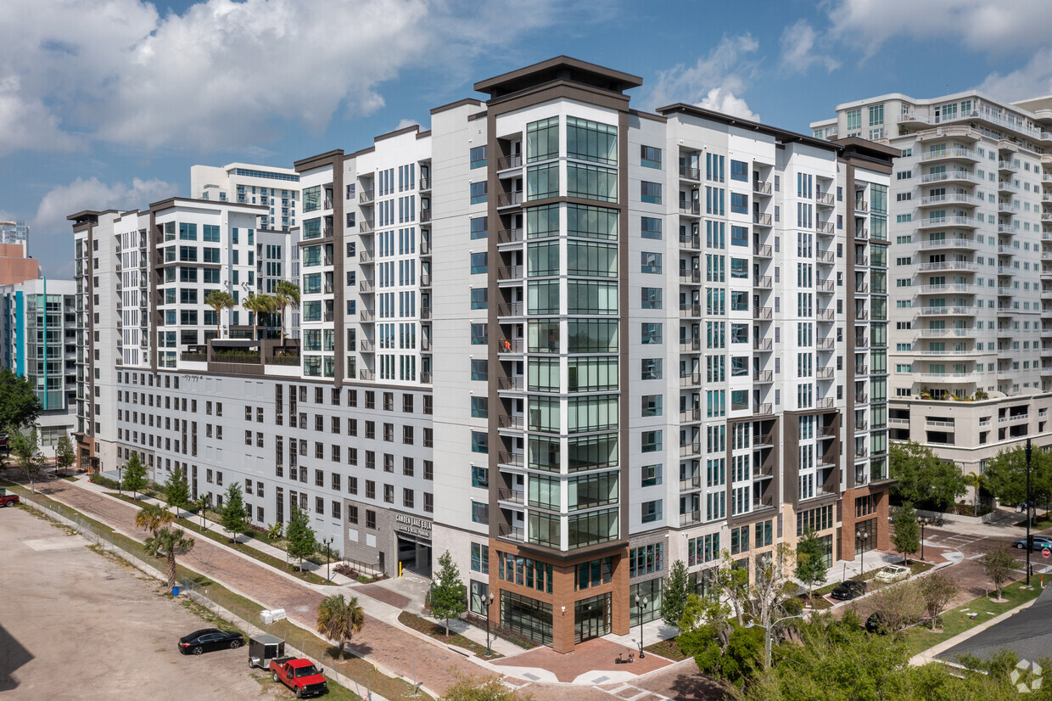


RETAIL SPACE FOR LEASE
IN THORNTON PARK
Lake Eola
520 EAST CHURCH STREET, ORLANDO FL 32801
12 STORIES / 364 UNIT HIGH-END MULTI-FAM COMMUNITY IN THE HEART OF THORNTON PARK
RETAIL GLA: 6,477 SF
860 SF AND 2,489 SF GROUND FLOOR RETAIL AVAILABLE (CAN BE COMBINED) 3,349 SF TOTAL
WALKING DISTANCE TO DR. PHILLIPS PERFORMING ARTS CENTER, LAKE EOLA, THORNTON PARK MAIN STREET, DOWNTOWN ORLANDO’S EVENTS & AMENITIES
CAMDEN RESIDENT DEMOGRAPHICS
39
$161,914
AVG AGE
AVG HH INCOME

Slide 2
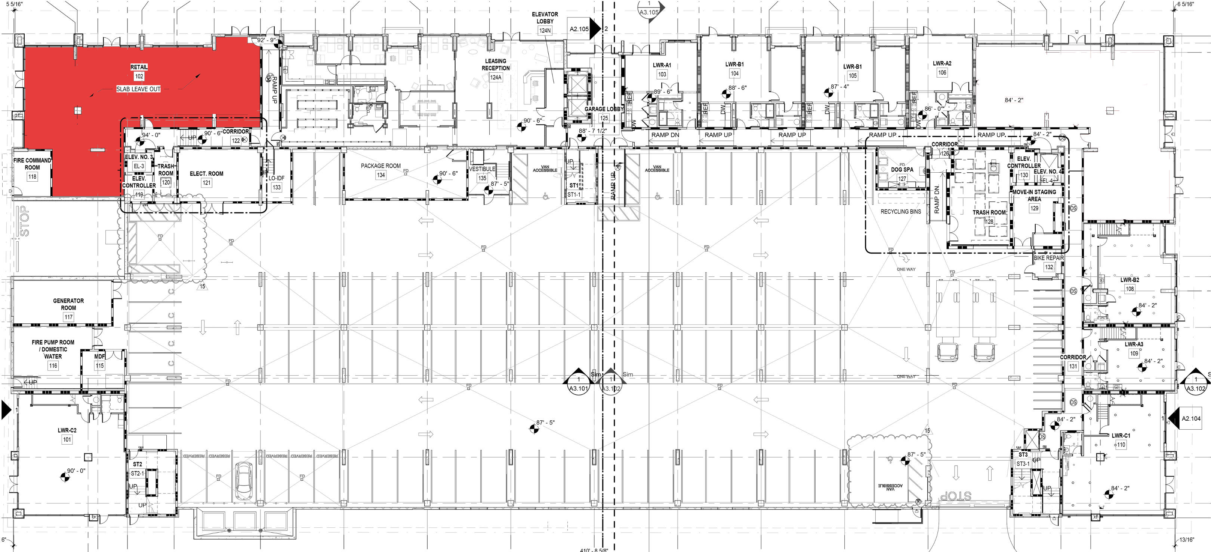
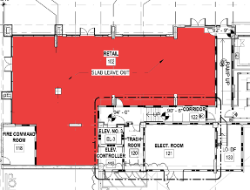
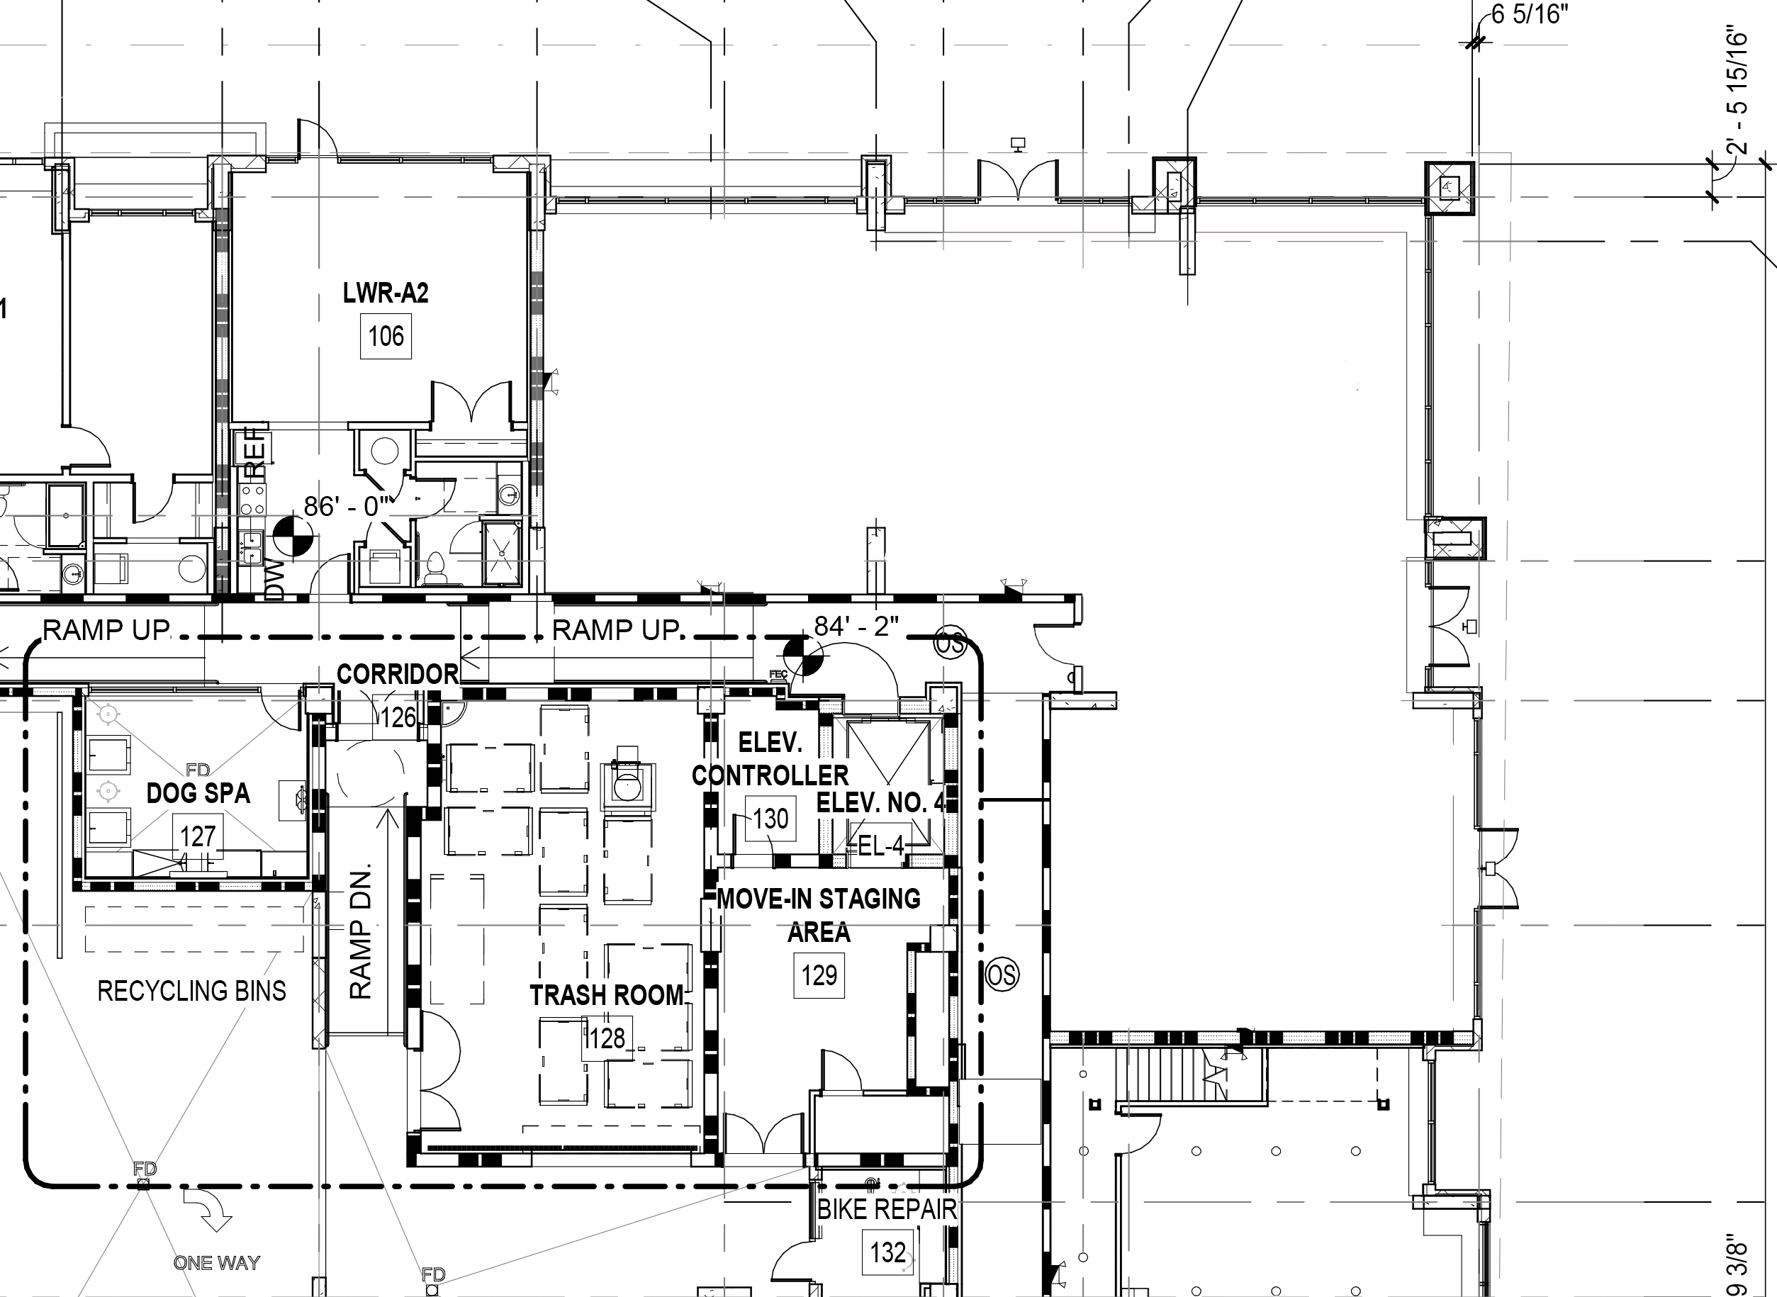

SITE PLAN
Lake Eola
E CHURCH STREET
STE 102
STE 107 | 3,128 SF
2,489 SF
860 SF
S OSCEOLO AVE
S EOLA DRIVE
STE 102
CAN BE COMBINED
(GRADE CHANGE BETWEEN SPACES)
STE 107
2,489 SF
AVAILABLE
EOLA NAIL & SKIN
CARE BAR
860 SF
AVAILABLE
MARIPOSA STREET
End-cap retail/restaurant space- with outdoor seating capability.

Slide 3
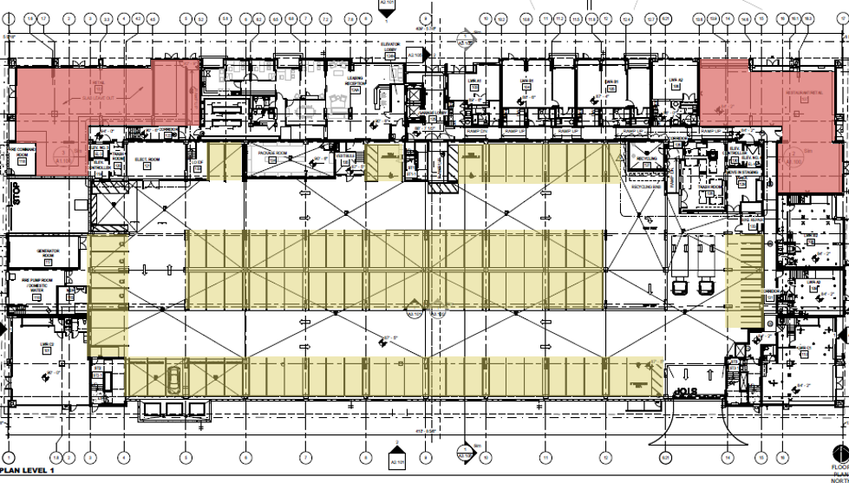
Lake Eola
Parking Plan
E. CHURCH STREET
STE 102
STE 107
S. OSCEOLA AVENUE
S. EOLA DRIVE
MARIPOSA STREET
3
Retail parking available- valet, garage parking spaces & ample street metered parking.

Slide 4

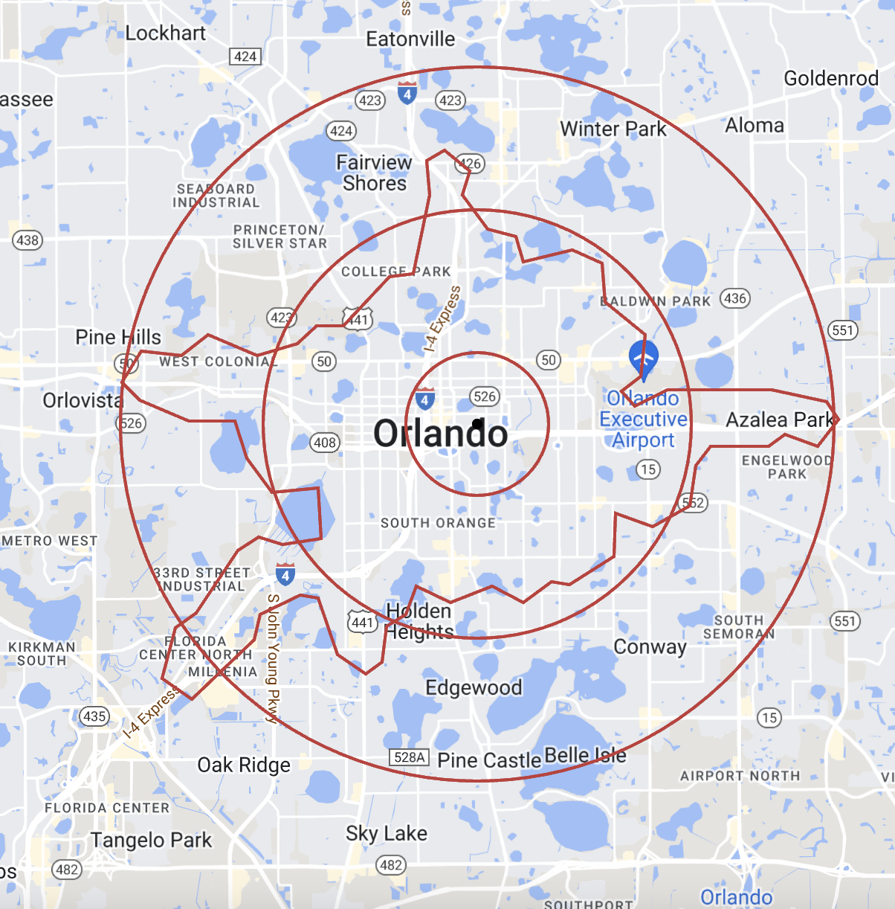








DEMOGRAPHICS
20,868
Population (1 mi)
$161,914
5 MILE
94
Avg HH Income
(1 mi)
Walkability Score
12,760
3 MILE
75
Households (1 mi)
99,110
1 MILE
Bike Score
10 MIN
60
Downtown Orlando
Employees
Transit Score
96.1%
Downtown Orlando
Retail Occupancy
 | 1 MILE RADIUS | 3 MILE RADIUS | 5 MILE RADIUS | 10 MIN DRIVE
TOTAL POPULATION | 20,868 | 113,599 | 308,356 | 115,510
HOUSEHOLDS | 12,760 | 55,758 | 134,339 | 54,833
EMPLOYEES | 43,011 | 111,399 | 215,953 | 118,746
BUSINESSES | 5,452 | 15,500 | 31,122 | 16,238
MEDIAN AGE | 39.7 | 38.5 | 37.5 | 37.8
AVG. HOUSEHOLD INCOME | $161,914 | $135,303 | $117,721 | $122,539

Slide 5
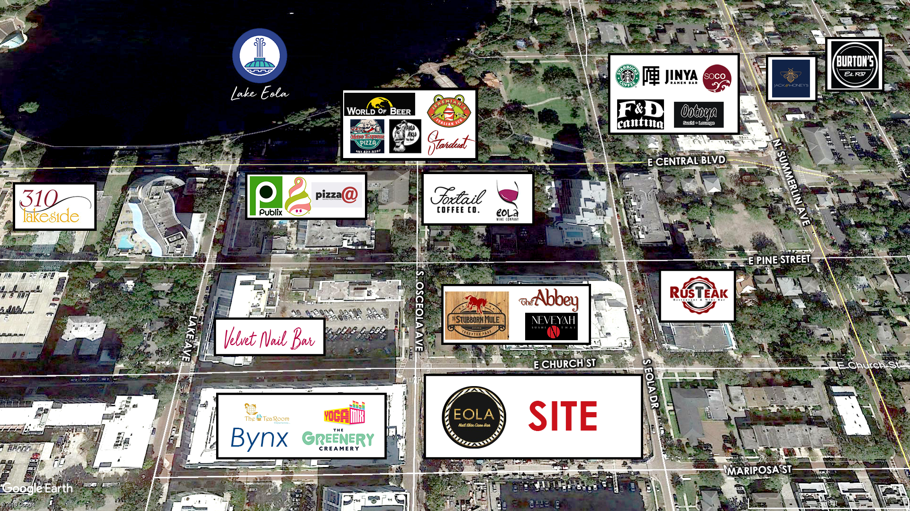
AERIAL OVERVIEW
Great
Part of
Wide Variety of
Join The
HISTORIC
MAIN STREET
LOCAL
VIBRANT
District
America
Events
Tapestry

Slide 6
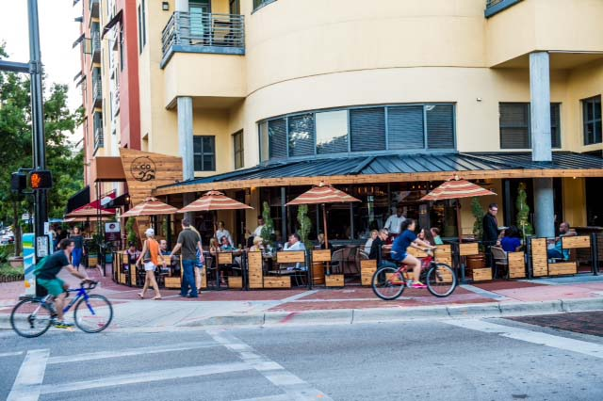
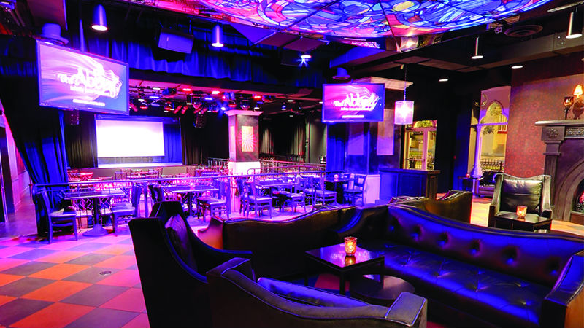
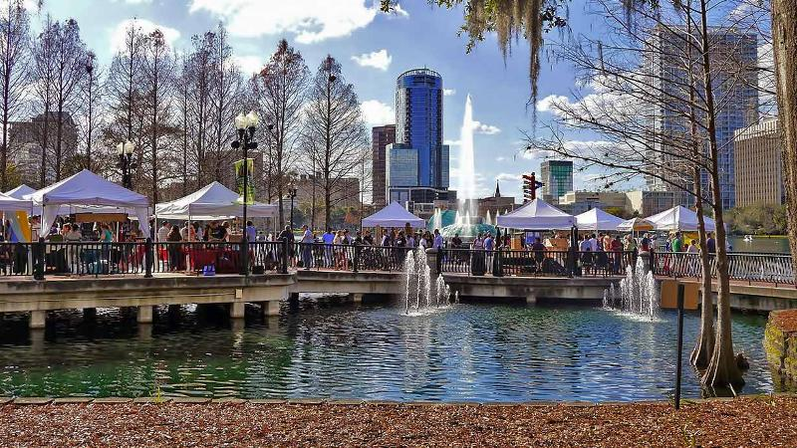
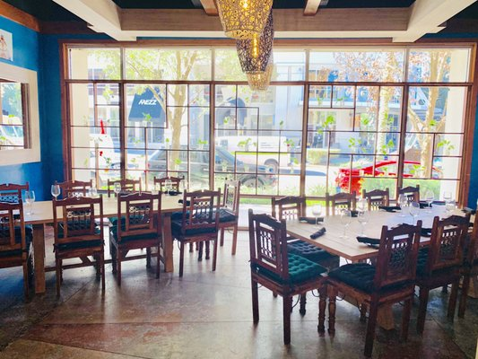
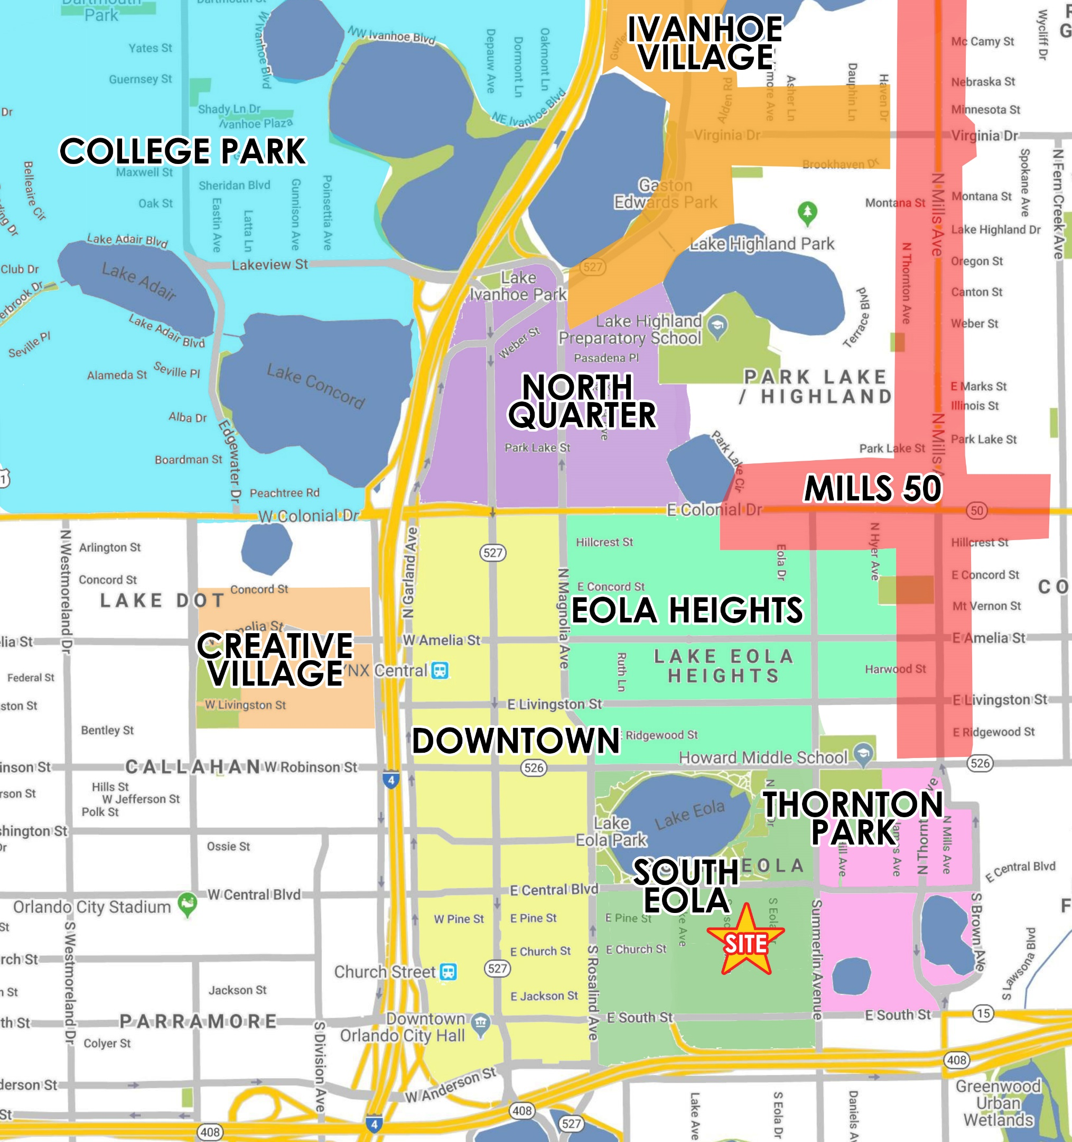
THORNTON PARK & SOUTH EOLA
“
“
The #1 Downtown District in Orlando
The Thornton Park & South Eola Districts features numerous upscale eateries, inviting neighborhood bars, & trendy boutiques.
Styles of homes range from 1920s bungalows to Craftsman-style structures to Tudor Revivals, all of them lining renovated brick streets with pristine landscaping. Adaptive reuse is also a calling card of the community.
Thornton Park has a very cosmopolitan feel, as it is the location of exclusive restaurants, high- end fashion boutiques, and The Sanctuary, which has some of the most expensive condo units in Orlando.
The Districts have also become one of the most desirable and expensive places to live in downtown, attracting young professionals as well as urban dwellers. As a result, the area has become a lively 24/7 neighborhood, with a diverse mix of people.

Slide 7
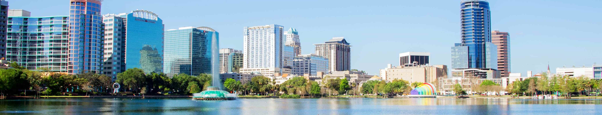
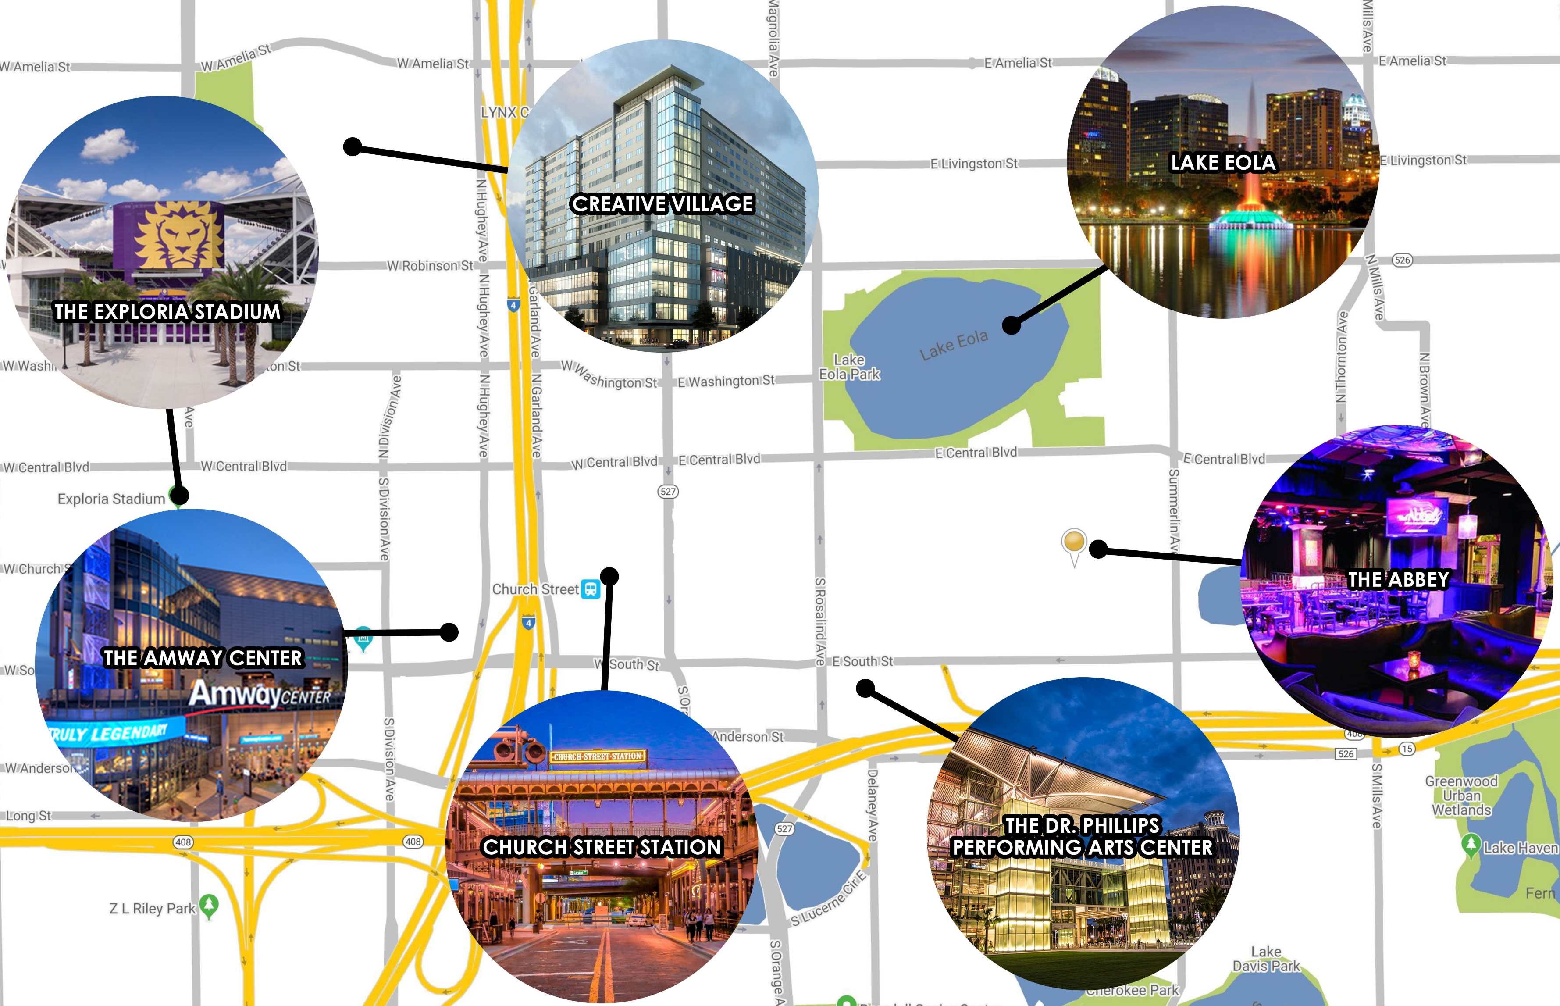

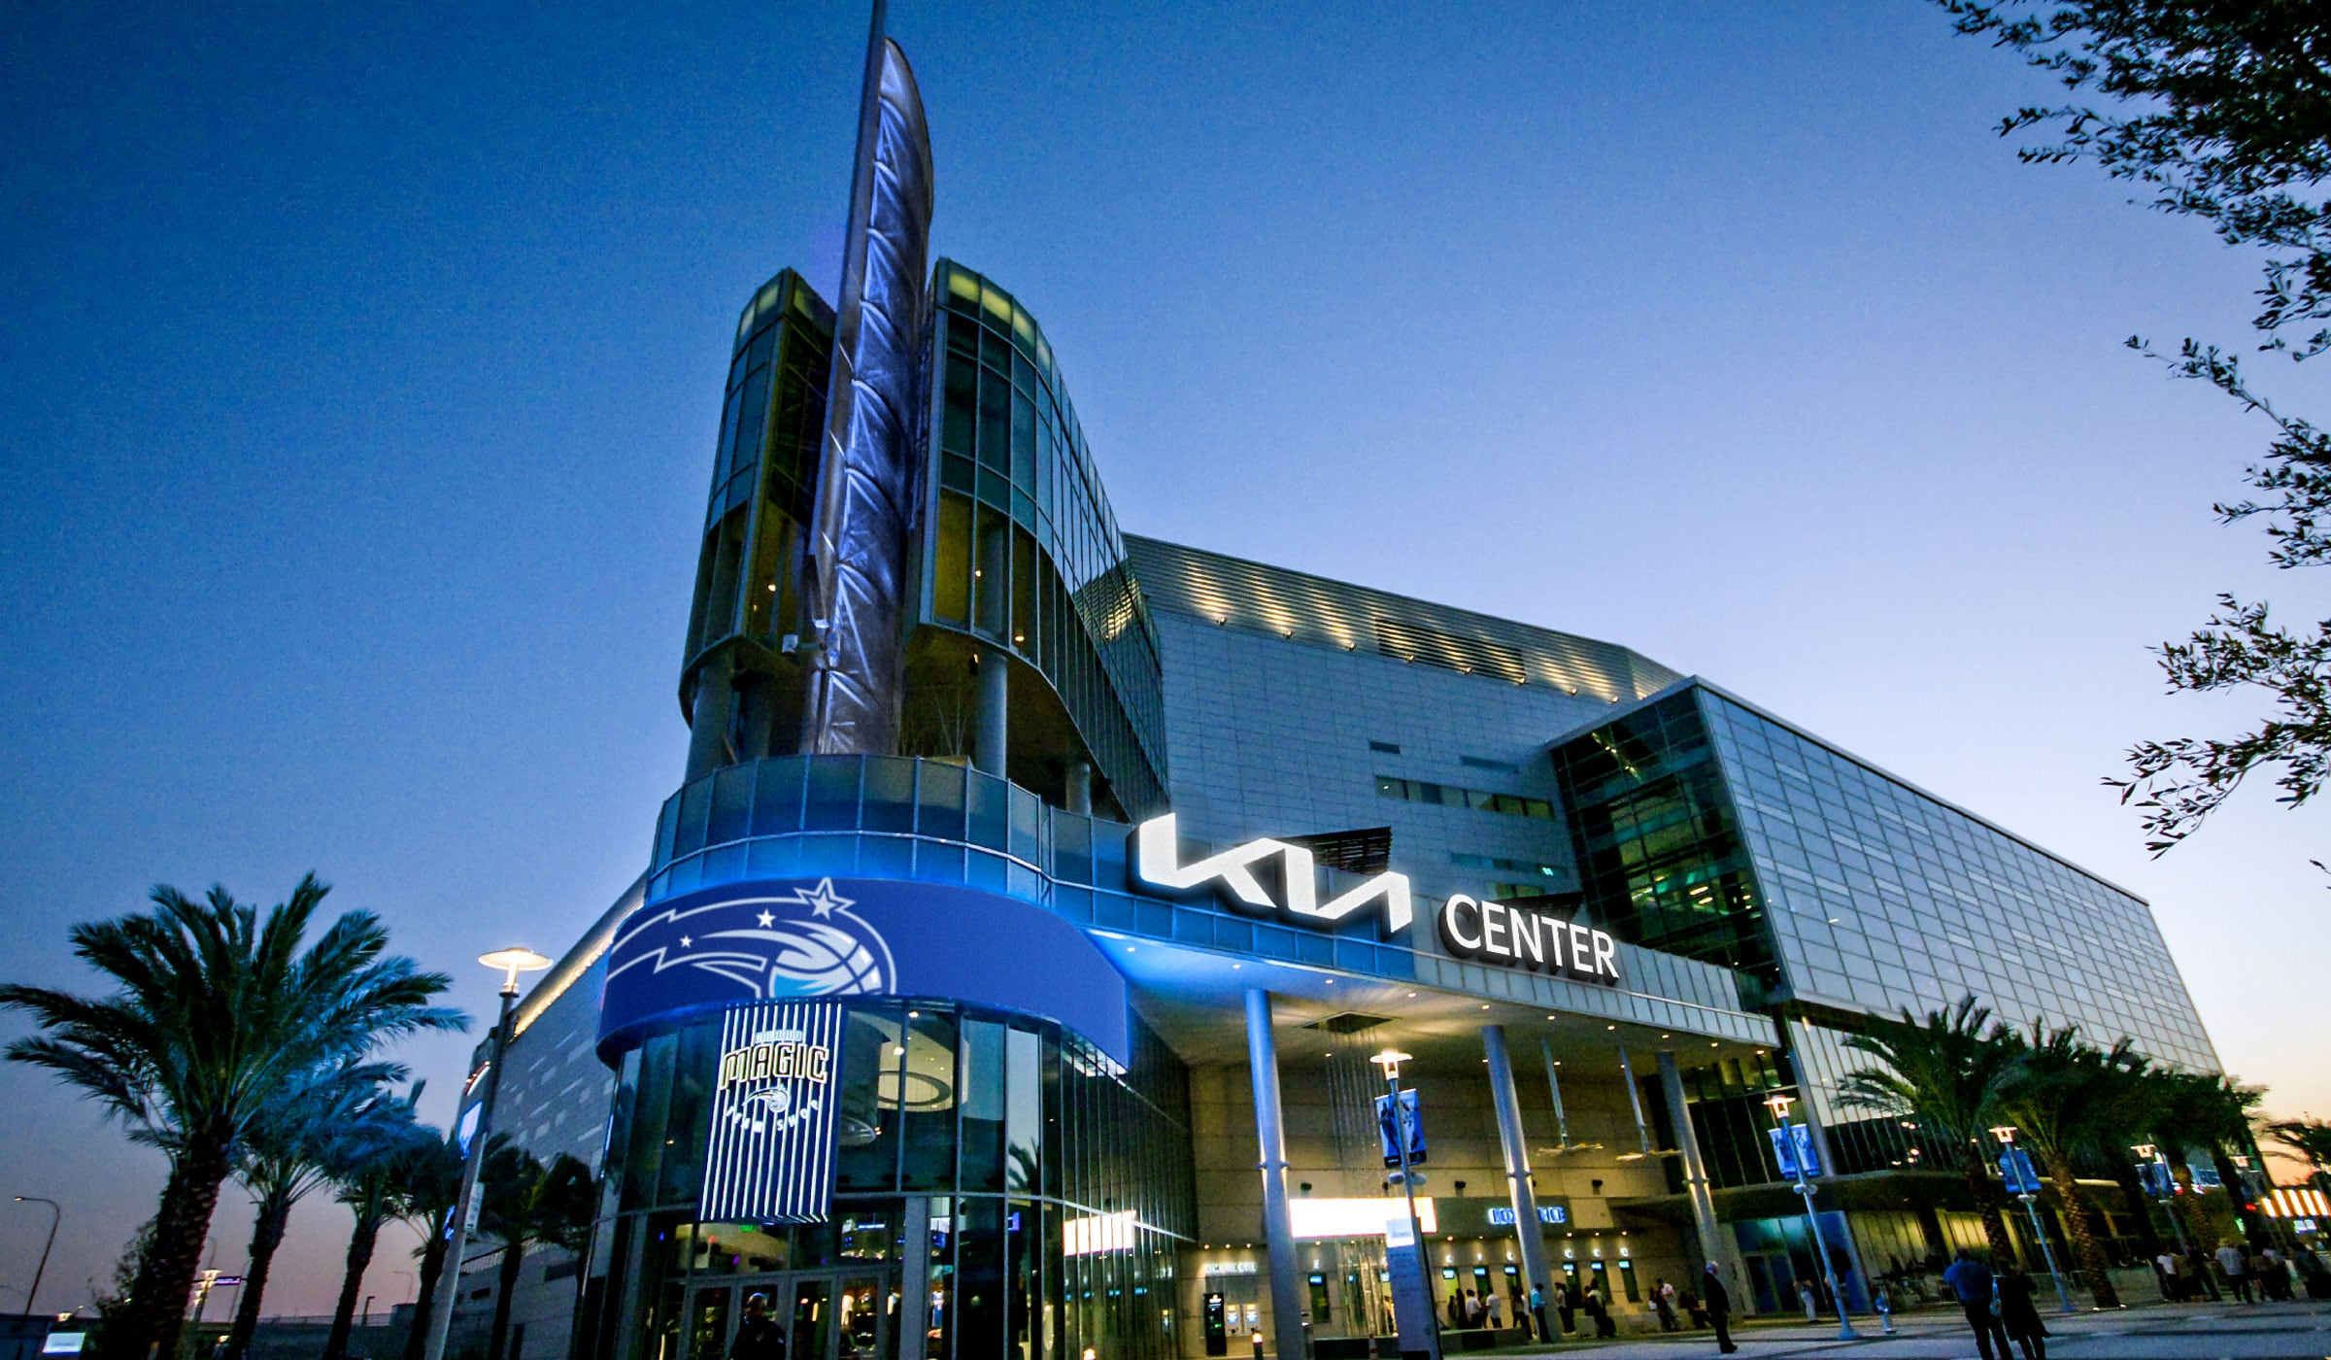
DOWNTOWN POINTS OF INTEREST
EXPLORIA STADIUM
25,500 capacity
Home to Orlando City Soccer Team & Orlando Pride National Women’s Soccer League
CREATIVE VILLAGE
68-AC mixed use urban infill neighborhood. Home to UCF/Valencia Downtown campus, offices, retail, residential and hotels
LAKE EOLA
Orlando’s destination park & home to the famous swans, a wide variety of events, Walt Disney Amphitheatre & Orlando Farmer’s Market
THE ABBEY
Thornton Park’s premier entertainment venue, hosting concerts, theatre, cabaret & more
THE DR. PHILLIPS CENTER
The two-block expanse is home to four premier theaters & school of the arts, with 5,125 capacity
CHURCH STREET STATION
Historic train station and retail space, home to a variety of restaurants & an entertainment venue
KIA CENTER
KIACENTER
20,000 capacity
Orlando’s sports and entertainment venue home to the Orlando Magic, Solar Bears & Orlando Predators

Slide 8
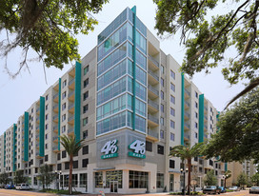
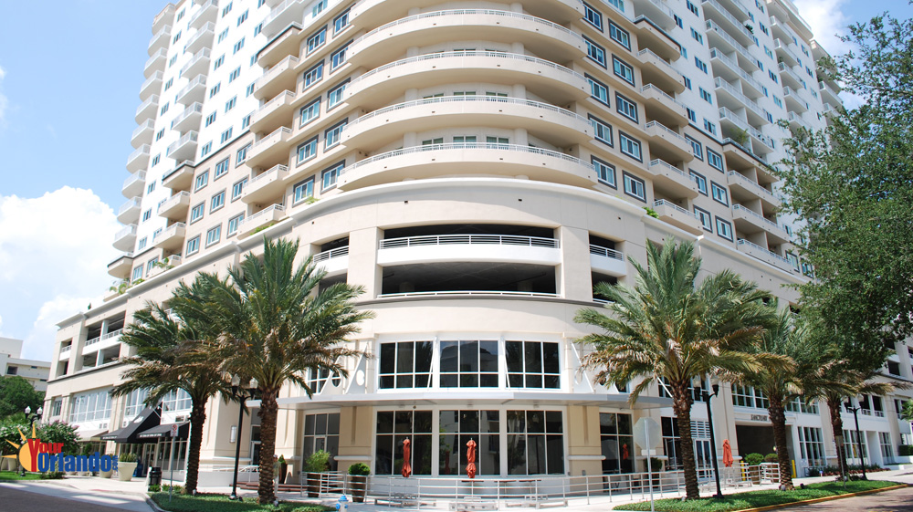
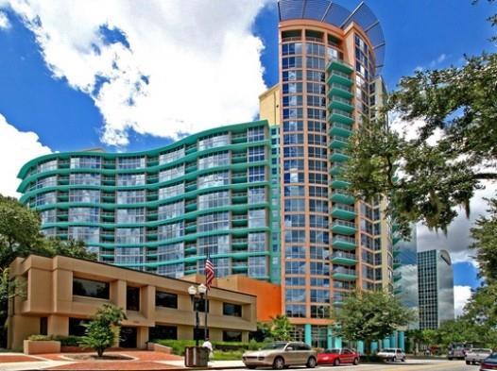
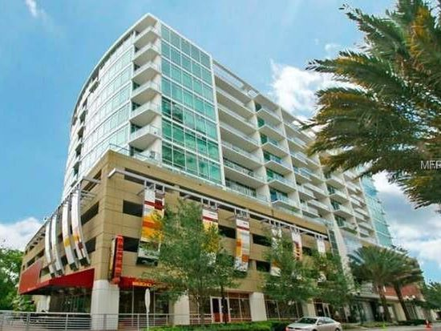
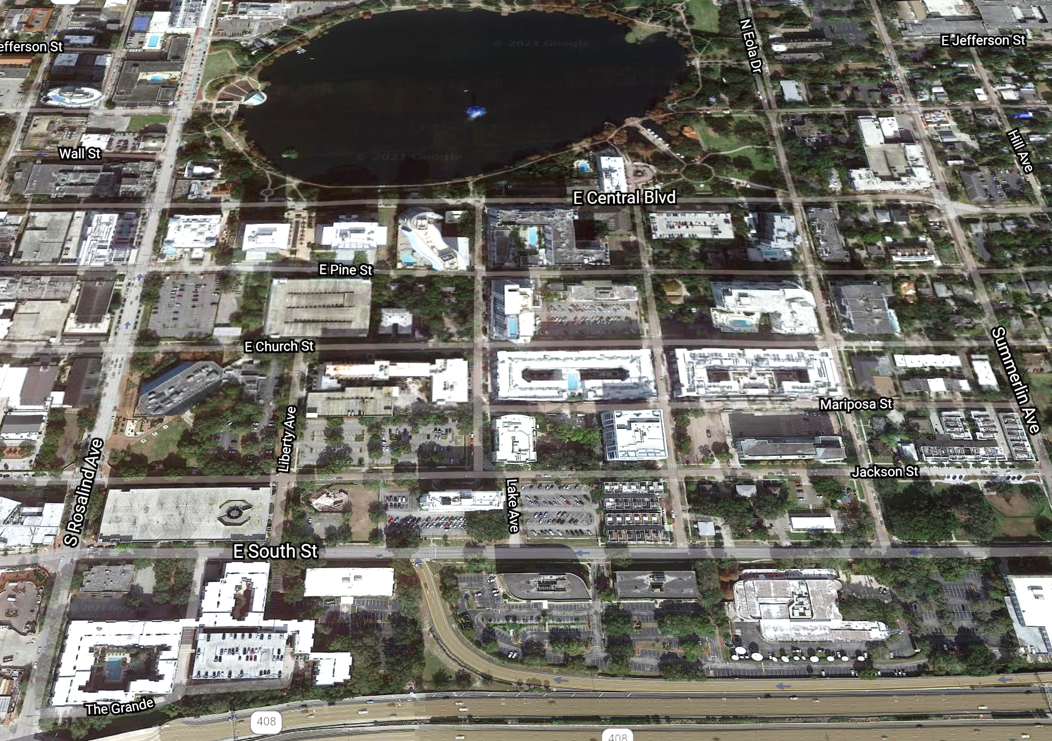
SURROUNDING RESIDENTIAL COMMUNITIES
SITE | CAMDEN LAKE EOLA | 364
1 | The Grande | 364
2 | Lutheran Towers | 304
3 | Windsor Place | 107
4 | Osceola Brownstones | 26
5 | Star Tower | 100
6 | Camden Thornton Park | 300
7 | Citi Tower | 235
8 | Baptist Terrace | 197
9 | The Waverly | 230
10 | Paramount on Lake Eola | 313
11-13 | Post Parkside | 238
14 | 530 East Central Condos | 91
15 | Eola South | 23
16 | Thornton Park Central | 49
17 | 101 Eola | 146
18 | The Sanctuary | 173
19 | Summer Winds Townhomes | 26
20 | Thornton Park Brownstones | 28
21 | The Jackson | 52
12
16
9
10
11
13
14
15
COMING
SOON
7
8
18
17
6
SITE
19
2
3
5
21
20
4
1
3,366 TOTAL UNITS

Slide 9
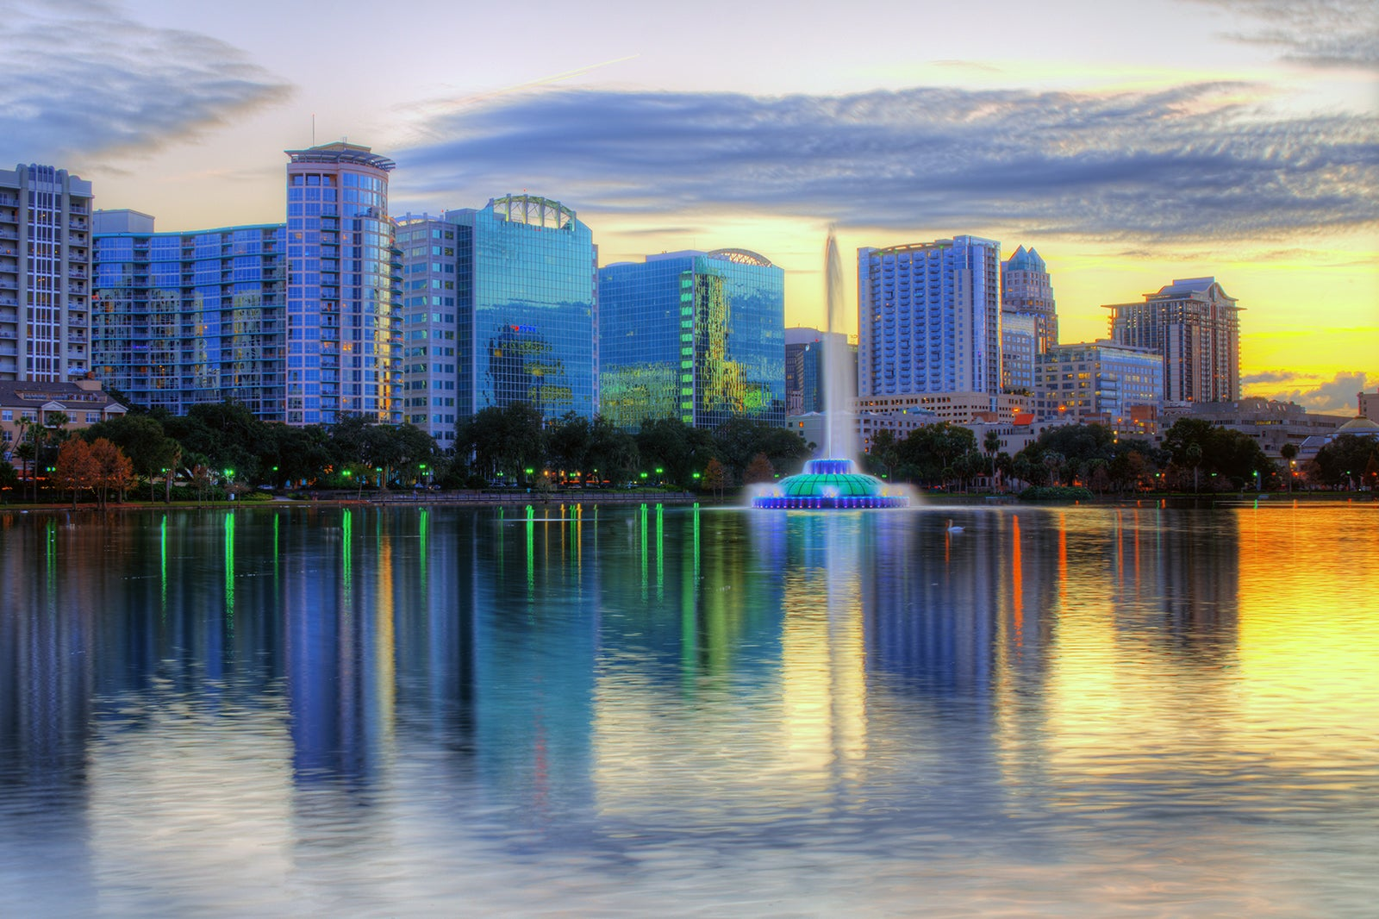
DOWNTOWN RETAIL & RESTAURANT STIMULUS PROGRAM
DOWNTOWN TENANTS CAN RECEIVE UP TO $400,000 FOR BUILD-OUTS AND RENTAL ASSISTANCE!
DOWNTOWN IS ON THE RISE AND SO ARE THE INCENTIVES. BUSINESSES COULD BE ELIGIBLE TO RECEIVE UP TO $400,000 (RESTAURANTS) AND $150,000 (RETAILERS) IN TENANT IMPROVEMENTS AND RENT EXPENSES ACCORDING TO THE COMMUNITY REDEVELOPMENT AGENCY.
THE ACRE TEAM IS HERE TO HELP TENANTS LOCATE THEIR DREAM SPACE AND GAIN ACCESS TO ALL INCENTIVES PROVIDED BY THE CITY OF ORLANDO.
TO LEARN MORE VISIT:
RETAIL STIMULUS PROGRAM

Slide 10
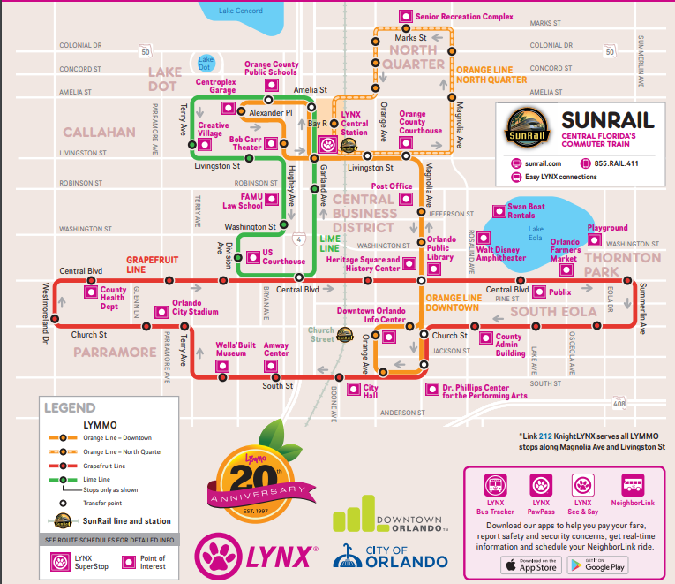
Downtown Orlando
Public Transportation
LYMMO allows you to conveniently see, feel and hear the heartbeat of the vibrant city of Orlando. And best of all, LYMMO is FREE and runs 7 days a week!
LYMMO quickly rides around Downtown in its own dedicated lane and controls stoplights throughout its three-mile route so you can easily get to your destination.

Slide 11




CONTACT ACRE
SERENITY LORENZ
SANDI BARGFREDE
Leasing Manager
Central Florida Office
serenity@acrefl.com
Cell- (904) 887-3302
Office- (407) 392-2055 x2`
Managing Partner
sandi@acrefl.com
Cell- (407) 491-8149
Office- (407) 392-2055 x2
Lic. Real Estate Broker
SERVING RETAIL MARKETS THROUGHOUT FLORIDA
CENTRAL FLORIDA | 47 E. ROBINSON STREET | SUITE 230 | ORLANDO, FL 32801
WEST COAST FLORIDA | 730 S. STERLING AVENUE | SUITE 210 | TAMPA, FL 33609
OFFICE | (407) 392. 2055 | FAX | (321) 400.1138 | WWW.ACREFL.COM
@acreflorida

